Slide 1

Developing Machine Learning-Enhanced AI Models for Underrepresented Transfer Students Counseling System (ACOSUS)
Sanjana Motte Vishwanatha. M.S.,
Department of Computer Science, Northeastern Illinois University
Under the guidance of:
Dr. Xiwei Wang, Department Chair & Project Advisor
Dr. Ken Sotak, Academic Advisor & Co-Advisor
Dr. Lizi Zhu, Third Faculty Member
Notes:
"Hello everyone, Good evening, welcome to my presentation. I'm Sanjana Motte Vishwanatha. Today, I’// be presenting my master project Developing Machine Learning-Enhanced AI Models for Underrepresented Transfer Students Counseling System (ACOSUS). This project is being carried out under the supervision of Dr. Xiwei Wang.

Slide 2
Outline
Background
Challenges
Objectives
How ACOSUS works?
Data Collection
Predictive Models
Neural Network?
Regression?
Output
Demo
Future work
Conclusion
Notes:
Beginning with the outline of the project,
First is the background of the project, where we'll explore the challenges faced by STEM students today
Followed with how ACOSUS is making a difference.
We'll set clear objectives to define the goals of our system,
then dive into the system's architecture and workflow to see how ACOSUS operates.
This will also cover the types of data collected from students,
followed by a discussion on the predictive power of neural networks and regression models, and why these techniques were specifically chosen for this project.
We'll then showcase the model outputs, highlight key performance metrics, and outline future enhancements. Followed by project demo.
Finally, we'll conclude with a summary of the system's significant impact and its potential for future developments, ensuring a comprehensive understanding of how ACOSUS is transforming educational support for STEM students.
This slide outlines the roadmap for the presentation.
Background of the project
Challenges: In this slide, I will be explaining about what are the challenges that STEM students are facing today. And how this project is being helping.
Objectives: Explain the goals of the system.
How ACOSUS Works: Details the system's architecture and workflow.
Data Collection: Describes what type of data are collected from students.
Predictive Models: Discusses the use of neural networks and regression models.
Why Neural Network & Regression: Explains why these techniques were chosen.
Outputs and Future Work: Presents model outputs, highlights performance metrics, and outlines the next steps.
Conclusion: Summarizes the system's impact and future potential.

Slide 3
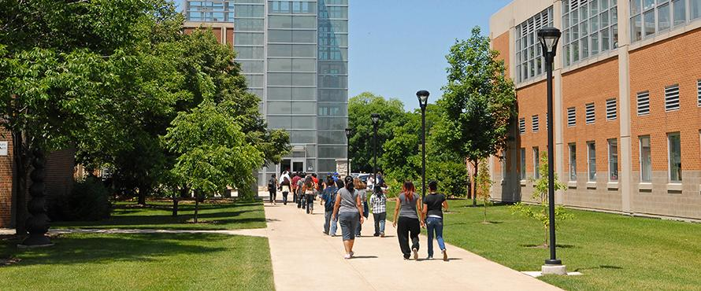
Bridging the Gap for URM Students in STEM
Determining preparedness for transferring to a four-year university is challenging.
Need for personalized support and guidance.
Notes:
Moving forward.
In STEM education, underrepresented minority students, particularly those at community colleges, face unique challenges when preparing to transfer to a four-year university. Many struggle with uncertainty—wondering if they are academically ready, if they have the right skills, or if they can adapt to a new environment. Advisors are there to help guide these students, but they also face limitations. Without comprehensive tools, it’s difficult to accurately assess each student's readiness. To explore these challenges further will move to the next slide.

Slide 4

Understanding the Challenges
Advisors often lack tools to evaluate students' preparedness for higher education transitions.
Risk factors for students include academic choices, demographic factors, and access to resources.
ACOSUS is a system that assesses readiness and supports advisors in guiding students toward success.
Notes:
The common and primary challenges that are faced is:
Firstly, Lack of Evaluation Tools for advisors.
There will be significant gap in the resources available to advisors example include students personal data, family background or career interest, along with the information they also lack the necessary tools to evaluate students' preparedness for higher education transitions effectively. Without sophisticated tools, advisors may struggle to assess the academic readiness and personal circumstances of students accurately
Secondly, Risk factors for the students.
This include academic choices, which can range from the selection of majors to specific course loads that may not align well with a student's capabilities or interests. Additionally, demographic factors also influence the success rate.
To address all these, ACOSUS come into picture.
ACOSUS is introduced to mitigate these challenges by assessing student readiness and providing comprehensive support. It aids advisors in guiding students more effectively toward academic and career success. By integrating advanced analytics and machine learning
Next, will dive into what are the main objective of this project.
—------------------------------------------------------
"Thank you sanjana:
Every student's journey is unique, and a one-size-fits-all approach doesn't effectively address individual needs."
"Personalized support is essential to help students navigate academic challenges, build confidence, and make informed decisions about their educational paths."
"But Without comprehensive tools, it's difficult for advisors to accurately assess each student's readiness."
"They may rely on limited data, such as GPA or completed courses, which doesn't provide the full picture of a student's preparedness."
"Advisors need deeper insights into factors like students personal circumstances and Access to resources to make informed recommendations."
“"This is where our Interactive AI-Driven Counseling System, or ACOSUS, comes into play."
"ACOSUS is designed to assess student preparedness comprehensively and provide actionable guidance."
“Over to Sanjana”
Demographic Factors: This term encompasses aspects like socioeconomic status, ethnicity, first-generation college student status, and other background information that can impact a student's educational journey.
Access to Resources: Highlights the availability of academic support, financial aid, mentorship programs, and other resources that can influence student success.
First Bullet Point:
Explain that advisors play a crucial role in student success but often lack comprehensive tools to evaluate each student's unique preparedness for transitioning to higher education levels.
Second Bullet Point:
Discuss how various risk factors affect student success:
Academic Choices: The courses and programs students select can impact their readiness.
Demographic Factors: Background elements like socioeconomic status, cultural expectations, and first-generation status can influence educational experiences.
Access to Resources: Availability of academic support, financial assistance, and mentorship can significantly affect outcomes.
Emphasize that understanding these factors is essential for advisors to provide effective guidance.
Third Bullet Point:
Introduce ACOSUS as the solution that equips advisors with the necessary tools and insights.
Highlight how the system aggregates and analyzes these risk factors to assess student readiness.
Explain that ACOSUS supports advisors in making informed decisions to guide students toward success.

Slide 5
Project Objective
Data Collection
Predictive Models
Preparedness Assessment
Collect data through web applications for key factor analysis and to improve predictive models.
develop a predictive model that estimates success rates based on user input.
Help advisors assess students' preparedness and guide them toward successful careers.
Notes:
So, having identified these challenges, let’s now look at how ACOSUS addresses them. First, we collect essential data through our web application, gathering information about students' academic performance and demographic factors.
Next, our predictive models analyze this data to generate a readiness score. As we collect more data, the models continuously improve in accuracy.
Finally, this readiness score helps advisors tailor their guidance to meet the individual needs of each student, while students themselves can identify where they need to focus more attention.
"With the key features in place, let’s take a closer look at how ACOSUS operates behind the scenes
—-------------------------------------------------
“As deep mentioned:
“Having outlined the challenges faced by URM students and the need for enhanced support, I'd like to present the core objectives of our project.”
Data Collection: "We are collecting the data via ACOSUS web Application this data includes academic performance, demographic information influencing student preparedness."
“Predictive Models”:
“We have developed custom predictive models which uses the collected data as source to provide a readiness score."
"As more data is gathered, we can refine our predictive models to enhance accuracy."
Preparedness Assessment:
"With this readiness score, advisors can tailor their guidance to address specific student needs along with this students can understand their strengths and identify areas for improvement."
The Key features will be further explained by Deep.

Slide 6
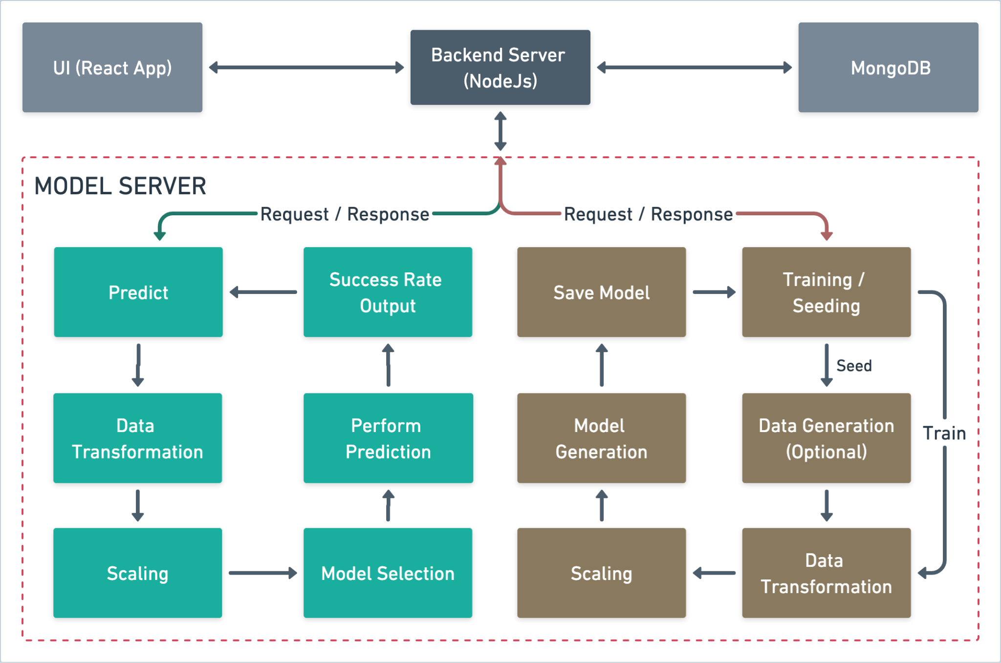
How ACOSUS Works
Notes:
At the front end, we have the UI, built using React, which serves as the main interface for students, advisors, and admins to interact with the system to collects data
. When students input their data or complete surveys, it is sent to the Backend Server, built with Node.js. The backend acts as an intermediary between the UI, the MongoDB Database, and the Model Server. All the data collected is stored in MongoDB and send to model server.
The real core of the project begins at the Model Server.
Data will goes through several stages of processing which is pivotal to the project’s success. First, the data is cleansed by eliminating null values and converting non-numeric data into numeric form to ensure uniformity. This is followed by scaling, we scale the data to ensure consistency before it moves into the prediction phase, where success rates are generated.
Each step will be explained further more in detail in upcoming slides. On the training side, if there isn’t enough data available, we seed the model for training, following the same steps. Once the model is trained, it is used to generate the readiness score, which is then sent back to the UI for students and advisors to access. This entire flow ensures that the data is processed efficiently and provides actionable insights to guide students and advisors.”
Now, will dive into each part.
—-----------------------------------------------------------------
"With these key features in place, let's take a closer look at the overall system architecture and see how ACOSUS operates behind the scenes.
"At the front end, we have the UI, built using React, which is the main interface students, advisors, and administrators interact with.”
"Next, we have the Backend Server, built using Node.js, which acts as the intermediary and communicates between the UI, MongoDB Database and the Model Server."
"All the data collected from surveys and student information is stored in MongoDB, our database."
Over to sanjana she will explain about how the model server works:
EXPLAIN THE MODEL SERVER
"As you can see, the system flows from the UI, through the Backend Server, into the Model Server where data is processed followed with data cleaning where we eliminate all the null values and transform all the non numeric to the numeric followed with scaling followed with predictions, and success rates are returned."
On the other hand, We are using the collected data to train the model, If data is not available we will seed data for training purpose follows the same steps at last the model is generated.
The generated model is used for prediction.
"Now that we've covered how ACOSUS processes and predicts student success behind the scenes, let's shift our focus to how different users interact with the system.”
Over to you Deep.
[Model Server: Core Processing]
System Flow Summary:
Flow of Data:
How It Works Together:
"This architecture ensures that student data is collected, transformed, and processed efficiently to produce actionable insights that help both students and advisors."
[Transition to Next Section]
Wrap Up:
"Now that we’ve seen how the system operates, let’s explore how these predictions and insights are utilized in real-time by students and advisors."
Engagement:
"This powerful system architecture enables us to continuously improve how we assess and support student success."

Slide 7
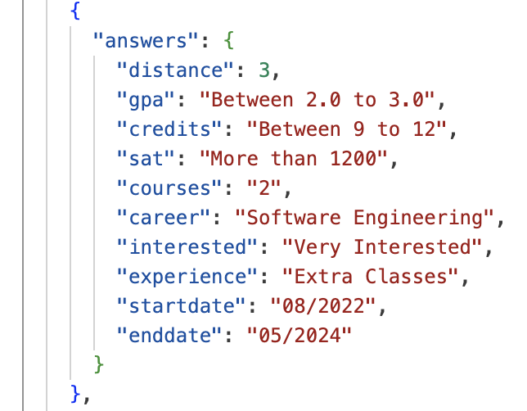
Data Collection
Academic Data
GPA
SAT score
Total Credits
Courses
Career Goal
Interest
Experience
Start Date
Demographic Data
Distance
Personal Data
Family income
Family Support
Scholarships
Personality Score
Notes:
We are gathering comprehensive academic and personal data about students to evaluate their preparedness.
The academic data includes information such as their GPA, SAT scores, total credits earned, courses completed, and their career goals. Additionally, we consider their level of interest in their chosen field, prior work or internship experience, their enrollment status (whether they have graduated or are currently studying), and their start date and expected graduation date. For graduates, we also track whether they secured an internship or a full-time job after completing their studies.
On the personal side, we collect demographic data to gain a broader perspective on factors that might influence their success. This includes:
Distance proximity: The distance between their home and the college, which may impact their daily commute and overall accessibility to resources.
Family income and support: Insights into their financial background and whether they receive support from their family, which can affect their ability to focus on academic goals.
Scholarships: Whether they have received any form of scholarship assistance, which might alleviate financial burdens and positively influence their academic performance.
Personality scores: to understand how personal characteristics, such as determination, and adaptability, contribute to their academic and career success.
This data is critical for developing predictive models that assess students’ preparedness, provide actionable feedback, and guide them toward achieving their academic and career aspirations.
On the right hand is an example of how data is structed in json.
In next slide will see in detail.

Slide 8
S. No. | Attribute | Type | Priority Score | Options (Value: Weightage) | Seed Data (Value: Probability)
 | GPA | Number | 9 | 4.0: 0.3, 3.5: 0.5, 3.0: 0.2 | 4: 0.3, 3.5: 0.5, 3: 0.2
 | Credits | String | 8 | 0 to 30, 31 to 60, 61 to 90, 91 to 120…… | 27: 0.3, 18: 0.2, 9: 0.2, 36: 0.1, 12: 0.2
 | SAT | Stiring | 9 | Below 500, between 500 to 800, more than 1200 1000 | More than 1200: 0.3, 1000: 0.3, below 500: 0.2, 1300: 0.2
 | Courses | Number | 6 | 3, 4, 2 | 3: 0.5, 2: 0.3, 1: 0.2
 | Career | String | 9 | Software Engineering, Data Scientist, ML Engineer | Software Engineer: 0.5, Data Scientist: 0.3, AI Engineer: 0.2
 | Interest | String | 5 | Extremely Interested, Very Interested, Slightly Interested, Not at all Interested | Extremely Interested: 0.2, Very Interested: 0.2, Moderately Interested: 0.2, Slightly Interested: 0.2, Not at all Interested: 0.2
 | Experience | String | 8 | Internship: 0.3, Project Done: 0.1, Paper Published: 0.3, Extra Classes: 0.2, Seminar: 0.1 | Project Done: 0.3, Paper Published: 0.1, Extra Classes: 0.3, Seminar: 0.2, None: 0.1
 | Family | Boolean | 9 | Yes, No | 0.2, 0.1
 | Personality | String | 8 | N/A
 | Scholarship | Boolean | 8 | Yes, No | Yes: 0.5, No: 0.5
 | Income | Boolean | 3 | Yes, No | N/A
 | Distance | Number | 7 | 10, 20, 4 | N/A
 | Work | String | 9 | Part-time, Full-time, Not-working | Part-time: 0.3, Full-Time: 0.3, Not-Working: 0.4
Notes:
This slide details the structure of data attributes used in the system, outlining how they are prioritized and utilized in evaluating the success rates of students in a predictive model. Each attribute is assigned a priority score ranging from 0 to 10, where 10 represents the highest level of importance. These priority scores are integral to the model as they influence the weight each attribute contributes to the overall success rate calculation. Here’s a detailed look at each component of the table:
GPA, Credits, SAT: These numerical attributes have high priority scores (9 for GPA and SAT, 8 for Credits) because of their significant impact on academic evaluations. Different values and weightages are provided for GPA and Credits, reflecting their varied impact on outcomes.
Courses, Career, Interest, Experience, Family, Personality, Scholarship, Income, Distance, Work: These attributes vary in type (number or string) and priority, illustrating their varied roles in the model. For instance, Career and Work are highly prioritized (9 and 9 respectively), emphasizing their critical role in determining career success. Interest and Experience have medium priority and are quantified through options such as 'Extremely Interested' or 'Internship', with assigned probabilities to indicate how frequently these might be expected to occur in the seed data.
Seed Data: This column shows the probability values associated with each attribute option. These probabilities range from 0 to 1, where 1 represents 100% certainty. For example, the GPA has probabilities assigned to different grades to reflect their expected distribution in the input data. This probabilistic approach helps generate a randomized dataset for model training when sufficient real data is unavailable.
Data Seeding: When insufficient data is available to train the model effectively, the system utilizes a data seeding mechanism. This involves generating a random dataset based on the seed probabilities defined for each attribute. Each piece of data is generated using a Python script that leverages these probabilities to ensure the synthetic data is as realistic as possible based on the expected distributions.
Overall, The table effectively sets the foundation for a robust predictive model by defining how each attribute should be considered during the data collection and model training phases. The priority scores and seed data probabilities are essential for preparing the model to generate reliable and accurate predictions of student success rates.

Slide 9
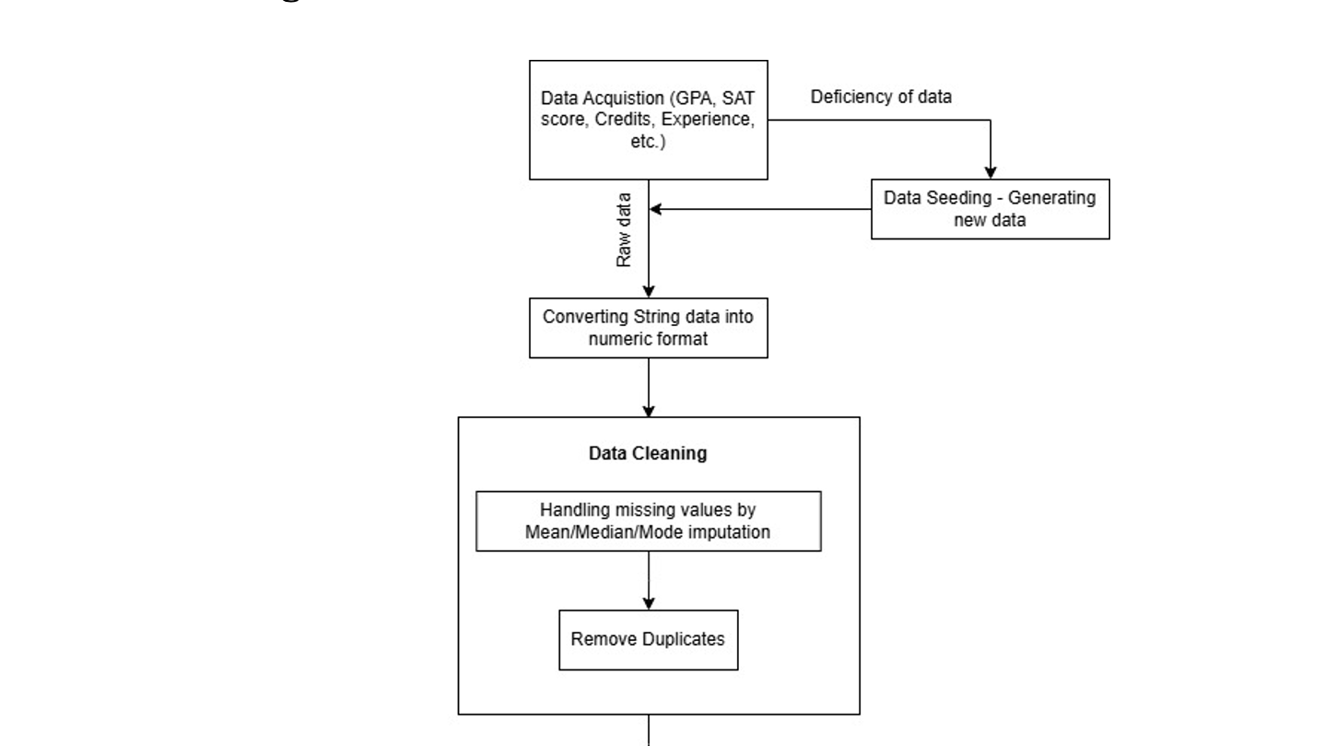
Data Cleaning
Notes:
Once the data is collected, the next critical step is data cleaning, which is essential for eliminating inconsistencies, inaccuracies, and missing values that could negatively impact the performance of predictive models and the overall functionality of the system.
Data cleaning involves several stages. One common issue with collected data is the presence of missing values. To address this, I utilized the isnull() function in Pandas to identify and locate missing entries, allowing for targeted cleaning of specific columns or rows. Depending on the nature of the data, different strategies were applied to handle these missing values. For numerical fields such as GPA or financial aid amounts, I employed Mean, Median, or Mode Imputation, where missing values were replaced with the mean, median, or mode of the respective dataset.
Another step in the cleaning process was the removal of duplicate entries. Using the drop_duplicates() function in Pandas, I identified and eliminated duplicates from the dataset, ensuring data integrity and accuracy.
Lastly, data normalization was carried out to address the issue of varying ranges across features. For instance, GPA typically ranges from 0 to 4, SAT scores span from 400 to 1600, and credit hours can range from single digits to the mid-thirties. To standardize these varying scales, I applied the MinMaxScaler technique, which transformed each feature into a uniform range between 0 and 1. This step was crucial for ensuring that all features contributed equally to the predictive models.
This systematic approach to data cleaning ensures that the dataset is reliable and ready for further analysis and modeling.
-------------------
Once The data is collected. The next step is data cleaning, Data cleaning is essential to eliminate inconsistencies, inaccuracies, and missing values that could affect the performance of predictive models and the overall system functionality
which involves several stages,
One of the common issues with collected data is missing values. I’m using the isnull() function in Pandas, which helps to locate missing entries, allowing for targeted cleaning of specific columns or rows.
If any missing values were detected, different strategies were applied depending on the nature of the data. One of them is Mean/Median/Mode Imputation. For numerical fields (e.g., GPA, financial aid amounts), the missing values were replaced with the mean, median, or mode of the existing data.
Next is removing the duplicates In the dataset, the drop_duplicates() function is used to identify and remove duplicates in the dataset.
Lastly data normalization, this step is crucial because, In many datasets, especially those involving diverse attributes, different features often have vastly different ranges. For example, GPA is typically measured on a scale from 0 to 4, SAT scores range from 400 to 1600, and credit hours can vary from single digits to the mid-thirtie. To address this I’m using the MinMaxScaler technique which will transform each feature into a range between 0 and 1.
-----------------------------------------------------------------------
The MinMaxScaler works by subtracting the minimum value of the feature and then dividing by the range (i.e., the difference between the maximum and minimum values).
Why not standard scaler?
StandardScaler standardizes the features to have a mean of 0 and a standard deviation of 1, which does not bound the data to a fixed range. Escepiallly for neural networks or machine learning algorithms that are sensitive to the magnitude of features (e.g., sigmoid or ReLU activations).

Slide 10
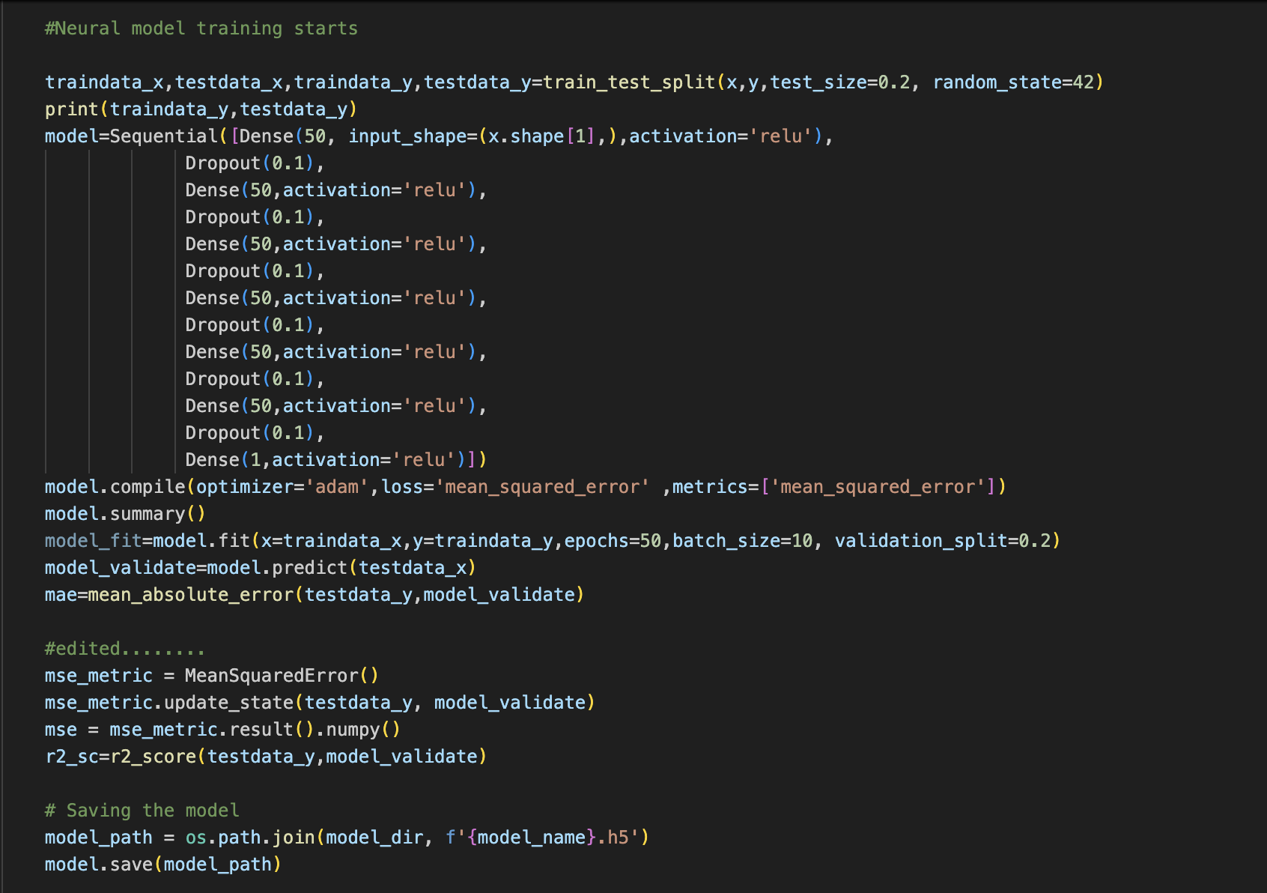
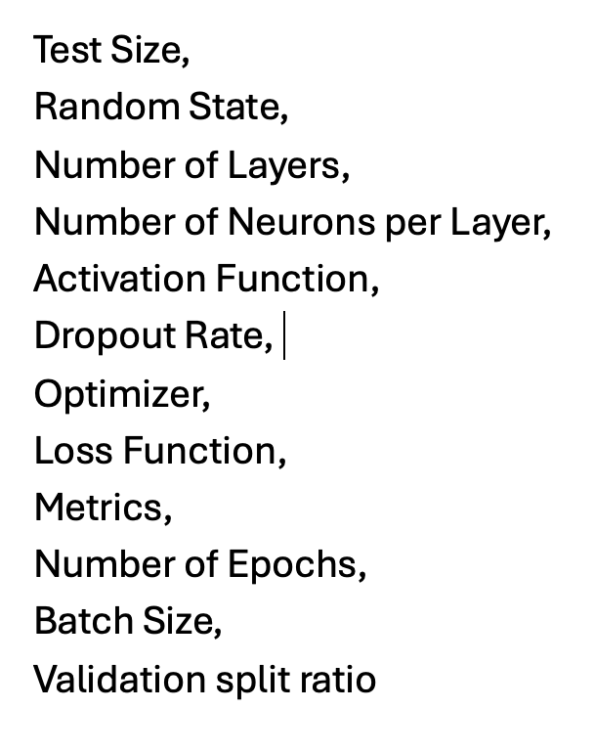
Predictive Models Neural Network Model
We chose a neural network model to generate the success rate because neural networks, especially multi-layer perceptrons (MLPs), excel in capturing complex, non-linear relationships between input features and the target outcome. For tasks like predicting success rates, which often depend on multiple interacting variables (such as academic performance, test scores, or external factors).
The neural network used for success rate prediction is created using the Keras The architecture consists of:
Input Layer: Accepts the number of input features equal to the number of questions or data points.
Hidden Layers: Several fully connected layers with 50 neurons each and ReLU activation function, which introduces non-linearity.
Dropout Layers: Applied after each hidden layer to prevent overfitting by randomly dropping a fraction (10%) of neurons during training.
Output Layer: Contains a single neuron predicting the final success rate.
Notes:
Neural networks are particularly adept at modeling complex, because of their non-linear relationships between variables.
In the context of student success, factors such as academic data such as GPA, and personal interests interact in non-linear ways that neural networks can learn and predict more effectively than other simpler models.
Along with this,
Neural networks can be updated with new data over time, allowing the model to adapt to changes.
the neural network model here is built using the Keras library in python.
It includes:
Input Layer: being the first layer of the network, which receives input features. The number of neurons in this layer corresponds to the number of input variables or features (questions or data points from surveys, tests, etc.).
Hidden Layers: These are the layers between the input and output layers. The slide specifies that several hidden layers are included, each containing 50 neurons. These layers use the ReLU (Rectified Linear Unit) activation function to introduce non-linearity into the model, enabling it to learn more complex patterns than a linear model would.
Dropout Layers: To prevent overfitting—a common problem in neural networks where the model learns the noise in the training data rather than the actual pattern—dropout layers are applied after each hidden layer. These layers randomly drop a specified percentage (10% in this case) of neurons in the previous layer during training, which helps to make the model more generalizable to new, unseen data.
Output Layer: This is the final layer in the neural network. It consists of a single neuron that provides the prediction of the final success rates. This setup suggests that the output is probably a continuous variable, indicating a regression task.
Before going to the analysis. The next slide will give brief about mse, mae and r2
Dense Layer: activation='relu': The Rectified Linear Unit (ReLU) activation function is used for these layers.

Slide 11
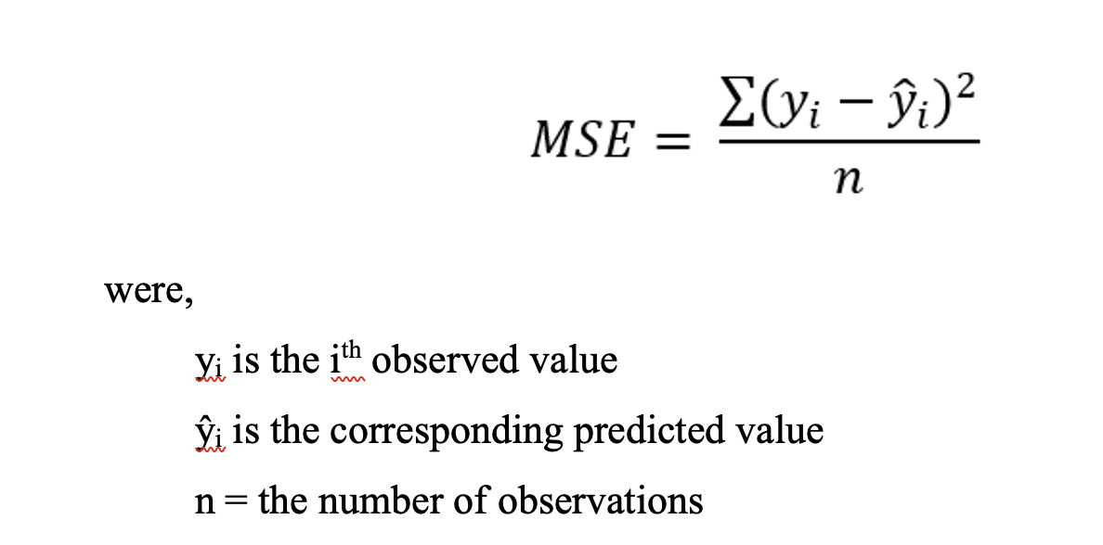
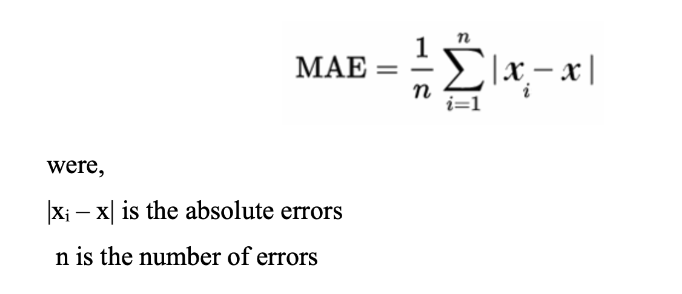
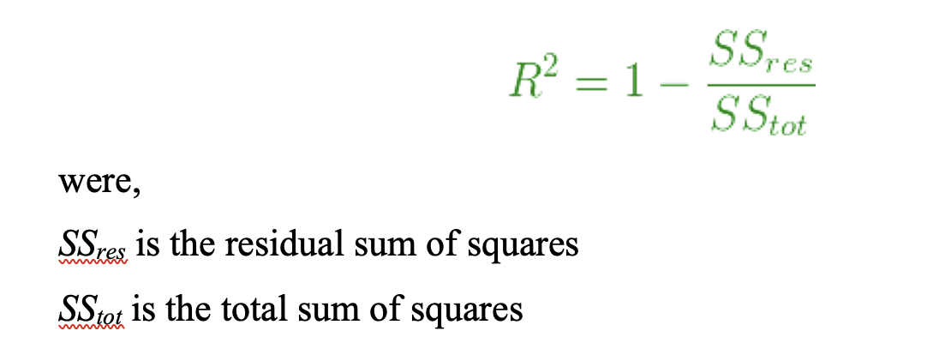
MSE, MAE and R2
Mean Squared Error (MSE): It measures the average of the squared differences between the predicted values and the actual values.
Mean Absolute Error (MAE): It represents the average of the absolute differences between the predicted values and the actual values.
R-square (R²): is a comparison of the residual sum of squares (SS_{res}) with the total sum of squares (SS_{tot}). The total sum of squares is calculated by summation of squares of perpendicular distance between data points and the average line.
Notes:
The three key statistical metrics used to evaluate the performance of predictive models: Mean Squared Error (MSE), Mean Absolute Error (MAE), and R-squared (R²). These metrics are critical for assessing how well a model's predictions match the actual observed values.
MSE:
Description: MSE measures the average of the squares of the errors, which are the differences between the predicted and actual values. By squaring the errors, MSE gives greater weight to larger errors. This characteristic makes it very useful in identifying models that have occasional but significant errors, typical in many real-world scenarios. The Lower the MSE, the higher the accuracy
MAE:
Components: xi−x represents the absolute errors between predicted and actual values.
n is the number of errors (observations).
Description: MAE measures the average magnitude of the errors in a set of predictions, without considering their direction (positive or negative errors do not cancel each other out). It is less sensitive to outliers than MSE and provides a direct indication of average error magnitude. The Lower the MAE, the higher the accuracy
R2:
Residual is the difference between actual value to the predicted value.
Description: R-squared is a statistical measure that represents the proportion of the variance for a dependent variable that's explained by an independent variable or variables in a regression model. It provides an indication of goodness of fit and thus a measure of how well unseen samples are likely to be predicted by the model. R-squared values range from 0 to 1, where 0 indicates that the model explains none of the variability of the response data around its mean, and 1 indicates that it explains all the variability.
The higher the R2, the higher the accuracy
These metrics collectively provide a comprehensive framework for evaluating the accuracy and effectiveness of a predictive model, helping researchers and practitioners to understand how well the model will perform in practical scenarios, adjust model parameters, and choose between different modeling approaches.
Let’s dig into each models one by one.

Slide 12
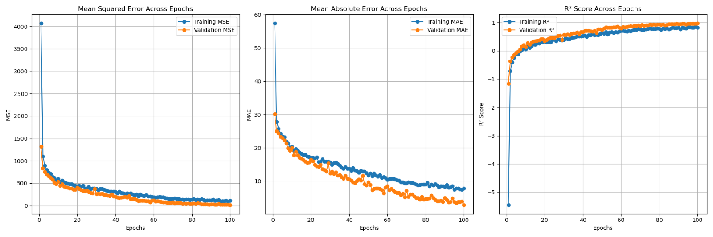
Neural Network Model Output
Notes:
In the hyperparameter tuning process for the neural network, I focus on exploring a range of key parameters to optimize the model's predictive accuracy
begin by dividing our data into training and testing sets, maintaining a standard 80/20 split. This approach ensures that our model is not only trained well but also rigorously evaluated on unseen data.
I explore several crucial hyperparameters, including the number of neurons in each layer, dropout rates, batch sizes, and the number of epochs for training.
These parameters are pivotal because they directly influence the model's ability to learn from the data and its performance stability:
Neurons: We vary between 50 and 100 neurons to determine the optimal complexity that the network needs to capture the underlying patterns without becoming overly complex.
Dropout Rates: Values of 0.1 and 0.2 help us assess how much neuron dropout is ideal for preventing the model from overfitting.
Batch Sizes: Testing with 10 and 20 helps in fine-tuning the model’s learning updates, striking a balance between computational efficiency and model stability during training.
Epochs: I consistently train each model for 100 epochs to sufficiently learn from the data while preventing excessive training times.
For each combination of hyperparameters, I construct a neural network with multiple layers, each followed by a dropout layer to mitigate overfitting. The model uses ReLU activation for non-linearity, which is essential for learning complex data relationships.
I compile the models to minimize mean squared error and track mean absolute error and a custom R² metric during training. These metrics are crucial for evaluating both the accuracy and the predictive power of the models.
Throughout the training process, I monitor and save the best model based on validation performance metrics. This systematic evaluation ensures I select a model that not only fits the training data well but also performs robustly on validation data, which is indicative of its ability to generalize to new scenarios.
By generating detailed plots for MSE, MAE, and R² across training epochs, I provide visual insights into the model's learning progression. This not only aids in understanding the model’s behavior over training iterations but also serves as a vital checkpoint for making informed adjustments to the training regime.
At the end of the hyperparameter tuning session, I summarize the best configurations based on the lowest MSE and the highest R² scores, ensuring that the final model selection is well-founded on empirical evidence. This model is then used for further validation or deployment.
Plot:
This plot displays the MSE MAE and R2 for the training set (blue line) and the validation set (orange line) throughout training epochs.
The MSE plot shows a rapid decrease in error as the number of epochs increases, which is indicative of the model learning from the data. The closeness of the training and validation lines suggests that the model is not overfitting significantly, as the validation error closely follows the training error, and both stabilize as training progresses.
The MAE plot demonstrates a decrease in error as well. It's noticeable that, the validation MAE decreases in tandem with the training MAE, indicating consistent learning across both datasets. The MAE is generally less sensitive to outliers than MSE, so its performance also being good underscores the model’s robustness.
Finally, The R2 plot shows that the R² score for both training and validation increases, which is a positive sign that the model is adequately capturing the underlying data structure without overfitting.
The convergence of training and validation lines in all three metrics suggests that the model is generalizing well, not just memorizing the training data.

Slide 13
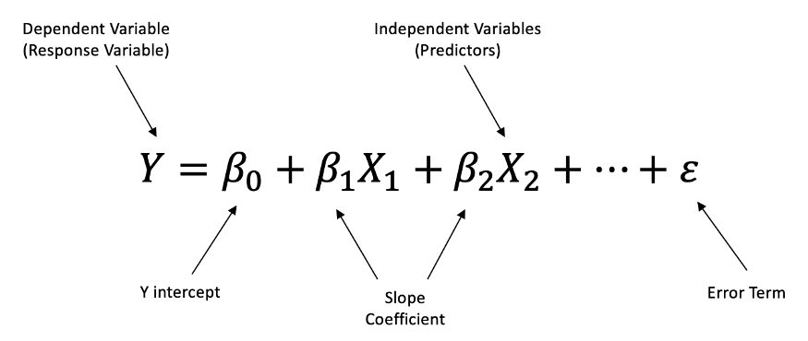
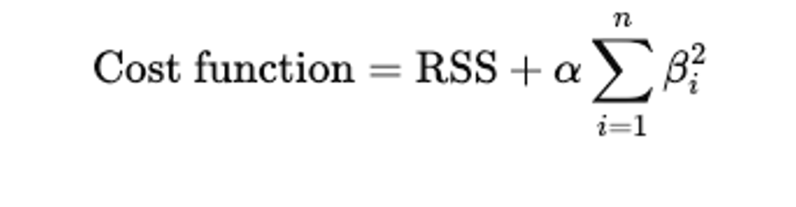
Predictive Models Regression Model
We chose a regression model to generate the success rate because regression is an excellent tool for predicting continuous values based on input features. In this case, the goal is to predict the success rate, which is a constant outcome, based on
The regression model is built using the Ridge(alpha)
Ridge regression is used in this because the data have high-dimensional features or multicollinearity,
Reduces overfitting by shrinking the coefficient.
In Ridge regression, the alpha parameter is a regularization term (denoted as λ\lambdaλ in some texts) added to the cost function. It helps prevent overfitting by penalizing large coefficients in the regression model
Notes:
Regression models are a cornerstone of statistical analysis and machine learning, designed to examine relationships between variables. They estimate the relationship between a dependent variable (the outcome) and one or more independent variables (predictors). By analyzing historical data, regression models can reveal trends and make predictions, making them essential tools, especially in education fields.
------------
The next model is that regression models are fundamental in predictive analytics, especially suitable for forecasting continuous outcomes based on multiple input features. In this project, the goal is to predict the success rate, which is a continuous variable, making regression an appropriate choice.
I have implemented a Ridge regression model for predicting success rates
Ridge regression is specifically chosen because it is effective at handling issues like high-dimensional features or multicollinearity among predictor variables. This is typical in educational data where many interrelated factors (like grades, courses, career status) might influence the success rate.
Ridge regression is a type of linear regression that includes a regularization term. The primary equation for a Ridge regression model is similar to least squares regression but includes a penalty for the size of the coefficients.
The cost function in Ridge regression is shown on the right-hand side of this slide. where RSS is the residual sum of squares, beta is the coefficients, and alpha is the regularization parameter.
Alpha (α\alphaα) is a hyperparameter that controls the amount of shrinkage: the larger the value of alpha, the greater the amount of shrinkage and thus the coefficients become more robust to collinearity. the alpha parameter reduces the model's complexity as well.
Choosing the right alpha is essential as it balances the trade-off between bias and variance, influencing model accuracy and generalizability. alphas = [0.01, 0.1, 1, 1.5, 4, 5, 10]
I have iterated over different values of alpha to find the optimal setting.
The model predicts outcomes for the test set. The mean absolute error (MAE), mean squared error (MSE), and R² score are computed for each iteration to evaluate model performance.
Which is shown in next slide.

Slide 14
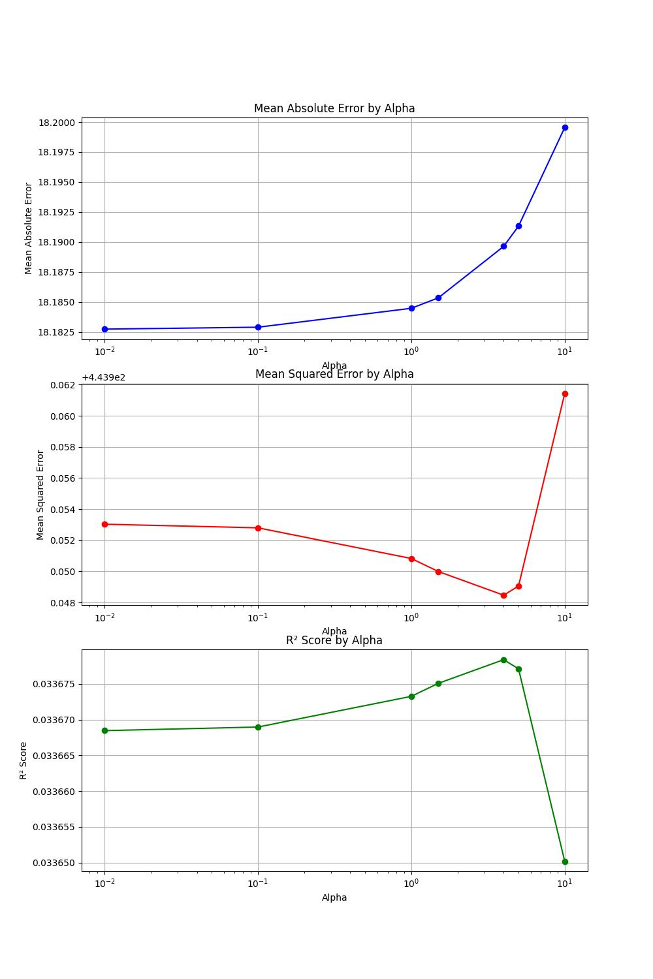
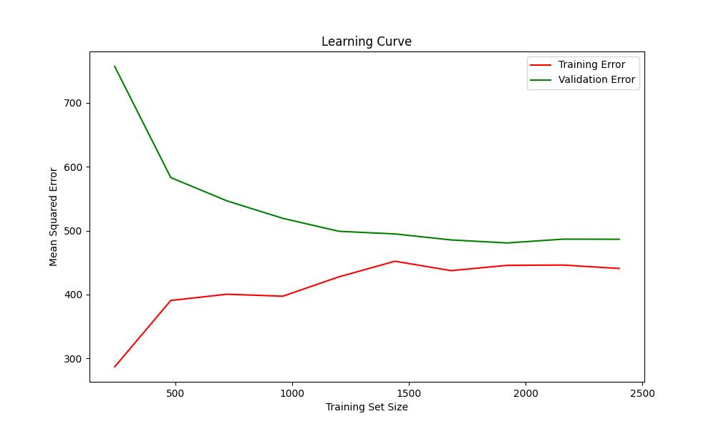
Regression Model Output
Notes:
performance metrics for a regression model, specifically visualizing the model's learning curve and sensitivity analysis results across different alpha value.
Top Right Plot: shows MSE, MAE, and R2 varying for different alpha parameters, displaying how MSE changes with different levels of regularization. The goal is to find an alpha that minimizes the validation error, indicating effective regularization that prevents overfitting. The same goes for MAE and R2
I used Ridge from the sklearn linear model and calculated MSE, MAE and R2 for each iteratino for alpha value. Used
The leftmost graph shows the learning curve of the regression model. It plots the mean squared error (MSE) on the vertical axis against the training set size and validation set on the horizontal axis. The curve includes two lines representing the training error (green line) and the validation error (red line).
This plot is implemented using a learning curve from sklearn model selection library, considering 5 cross-validation folds
(neg_mean_squared_error scoring as. default)
The learning curve is essential for understanding how well the model learns as more data is provided. Ideally, both training and validation errors should decrease as the training size increases, indicating that the model is learning effectively and generalizing well to new data.
In this, both training and validation errors are decreasing. A persisting gap between the training and validation lines could indicate overfitting, where the model learns the training data too closely and performs poorly on unseen data.
To conclude, Multiple regression is not well suitable especially when the dependent and independent variables are not co-relating.
Moving futher..

Slide 15

Generative AI
GPT-3.5 is be used to provide detailed feedback to students along with their predicted success rate.
Based on the predicted success rate and the input factors, GPT-3.5 generate context-specific feedback.
Personalization: GPT-3.5 craft responses that are specific to the student’s individual situation based on their success rate and influencing factors.
Language Understanding: GPT provide feedback in a human-like, conversational tone that is easier for students to understand and act upon.
Adaptive Feedback: Depending on whether the success rate is high or low, GPT can provide motivating feedback or constructive criticism that encourages students to improve.
Notes:
Open aI is implemented to enhance student support and feedback mechanisms based on predictive analytics from the models.
GPT- 3.5 turbo model is utilized to provide detailed, personalized feedback to students regarding their predicted success rates. This utilization of AI in education helps in creating a more interactive and responsive learning environment.
By leveraging the success rates predicted by models and considering various input factors (such as academic performance, family background, etc.), GPT can generate tailored feedback. This feedback is not generic but is customized to each student's specific situation, enhancing the relevance and potential impact of the feedback.
GPT-3.5 uses its advanced natural language processing capabilities to deliver feedback in a conversational, human-like tone, making it easier for students to understand and relate to the information being provided.
The function accepts a prompt that contains the contextual information necessary for generating the feedback. This prompt could include details about the student's performance, behavior, and other relevant data.
The function sends a request to the OpenAI API, specifying that the GPT-3.5-turbo model should be used. The request includes the prompt in a structured format where the role is set as "user" and the content carries the actual prompt.
Once the API processes the request, it returns a completion which includes the AI-generated feedback. This feedback is then printed and also packaged into a JSON response, making it suitable for web-based applications where such responses can be handled and displayed to end-users.

Slide 16
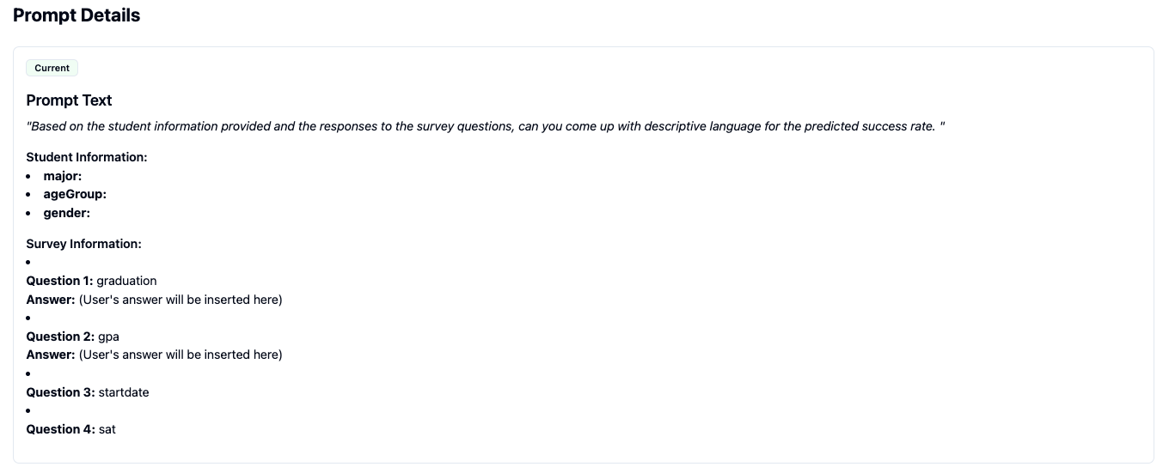
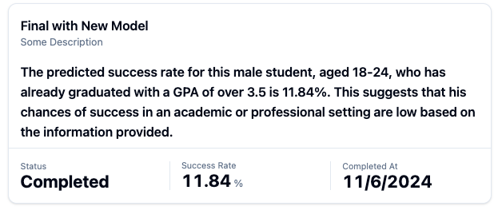
GPT Output
Prompt 1
Output
Notes:
This is just an example of the prompt and its output. We need to refine the prompt.

Slide 17

Notes:
Will move to the demo part, Here I will show you about the questions we are asking for the students. And the model output and also the gpt implementation.

Slide 18

Conclusion and future work
The comparative analysis of the deployed models revealed a significant finding: the neural network model outperformed the traditional regression model.
Future Enhancements:
Focusing on refining and expanding the capabilities of its AI-driven models
We will leverage GPTs Prompts to transform success rates into detailed feedback, highlighting students' strengths and weaknesses.
Plan to integrate a chatbot for real-time student assistance.
Notes:
To conclude, ACOSUS empowers students by providing personalized insights that help both students and advisors make informed decisions. The readiness score highlights strengths and areas for improvement.
Looking ahead, I plan to leverage the GPT prompt to provide detailed feedback. Additionally, and Focuses on refining and expanding the capabilities of its AI-driven models. A key area
of development will be the further investigation and enhancement of deep learning
models, which have demonstrated significant potential in understanding and predicting student outcomes more effectively than traditional methods.
Aiming to incorporate additional layers and tuning the hyperparameters of existing neural networks
With that, I’d like to acknowledge. conclude the presentation.
—--------------------------------------------------

Slide 19



Acknowledgments
Deep Mandloi, M.S.,
Notes:
The development and progress of this research project would not have been
possible without the invaluable support and guidance of
My mentor Dr. Xiwei Wang,

Slide 20
Thanks!
Any questions?
aiacosus@neiu.edu | http://cs.neiu.edu/acosus
Notes:
Thank you for your time
”I would love to hear your thoughts, or suggestions and answer any questions you might have. Please feel free to ask.”

